Slide 1
Project Title: Plant & Security Surveillance Improvement - Okoloma CCTV Revamp
Charter Template
Business Case/ Objectives:
In the past, control room personnel were able to do visual monitoring of the Okoloma Gas Plant & Afam remote Manifold Process Areas and their perimeter fence areas in real-time with full functionality of the CCTV system. The CCTV system is currently obsolete not functional and has reach OEM end of life and support. There is opportunity to reduce or eliminate the cases of theft and vandalism, improve Control Room Operator response to process challenges around the Gas Plant and Afam Remote Manifold.
Potential Benefits & Measurement:
Improve security surveillance at Okoloma Gas Plant and Afam Remote Manifold.
Improved response time to theft / vandalism scenarios.
Deterrent to prospective vandals and thieves.
Enhance security breach investigation experience
Optimise patrol resource around Gas Plant perimeter
Improve Control Room Operator Response to process issues.
Project Scope/Actions :
Secure Management approval
Site Assessment Report Issued
Draft scope of work ready
CMT Appointed
Contracting strategy agreed
Cost estimates ready
Part A approved
ITT issued
Contract Awarded
Kick-off meeting held
Pre-mob/ Mob vendor
Site installation & Testing
Training of Ops & Mtc.
Documentation handover & Reliability test
Vendor Demobilized
Critical Success Factors:
Asset Leadership/Stakeholder Support
Project Sponsor: Florence / Ikechukwu
Implementation Lead: Pius Adegoke
Project Team:
Dijana Adegor
Dozie Emeana
Efuribe Chinagozi
Chioma Onwuteaka
High-level Timeline:
L0-L1: May 2018
L2: May 2018
L3: Aug. 2018
L4: Aug. 2018
L5: 30 Oct. 2018
Initiative End (30 Oct. 2018)

Slide 2
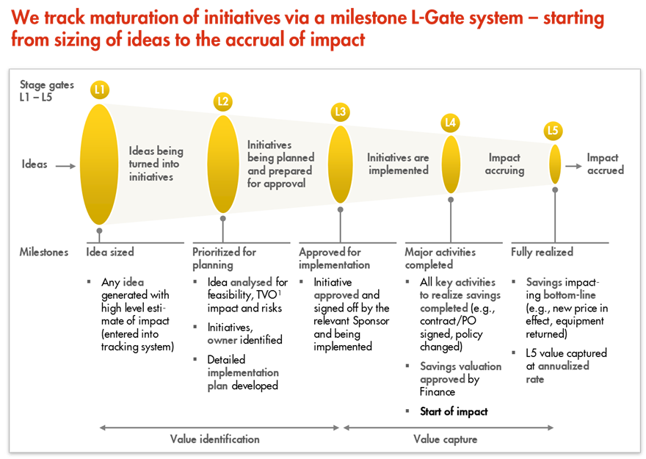
L1 – L5 Gates

